Slide 1

Introduction to Ansible

Slide 2


Slide 3
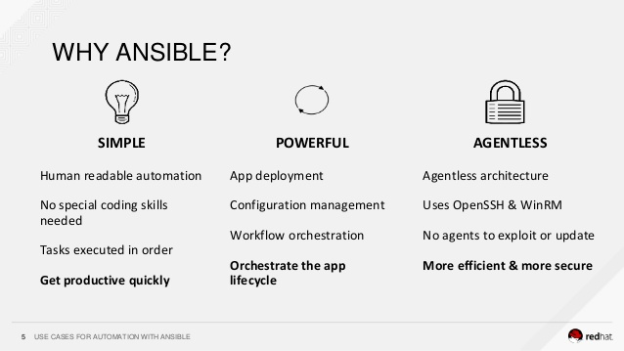

Slide 4
Ansible Use Cases
Provisioning environments
Configuring operating systems
Deploying applications
Performing compliance checks

Slide 5
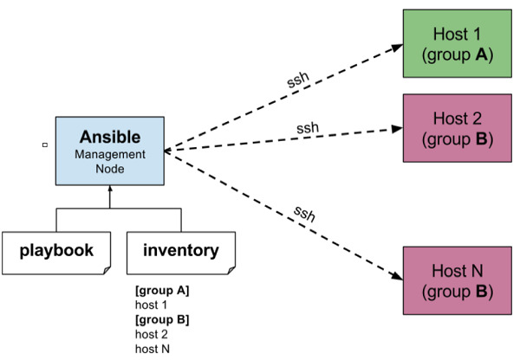
Architecture of Ansible

Slide 6
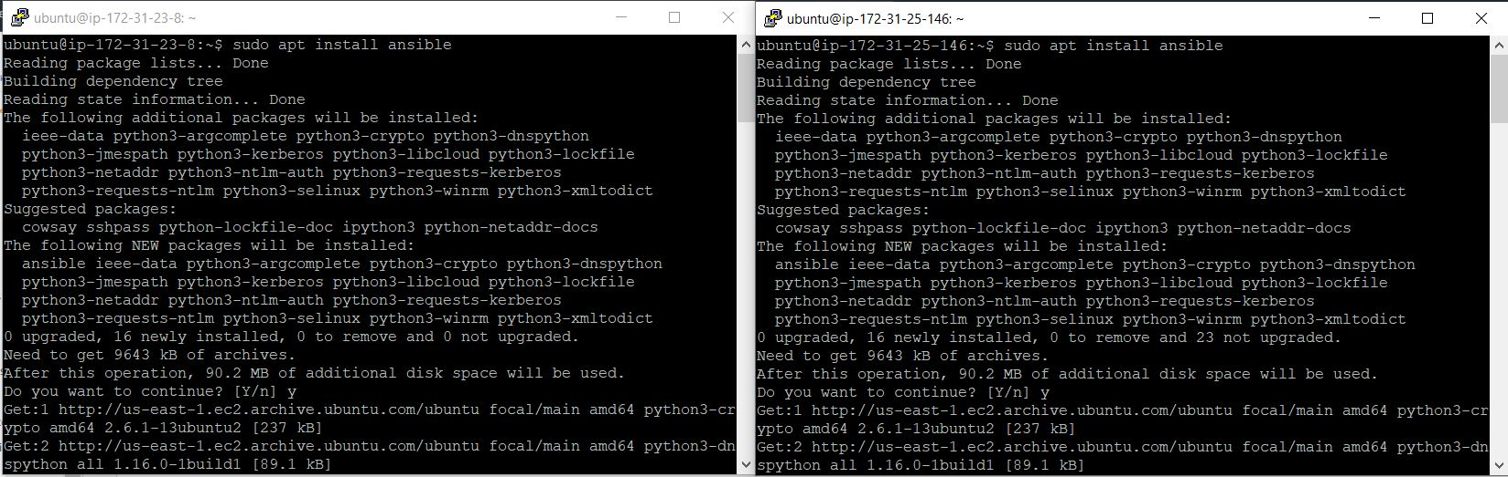
Installing Ansible
$ sudo apt install ansible

Slide 7
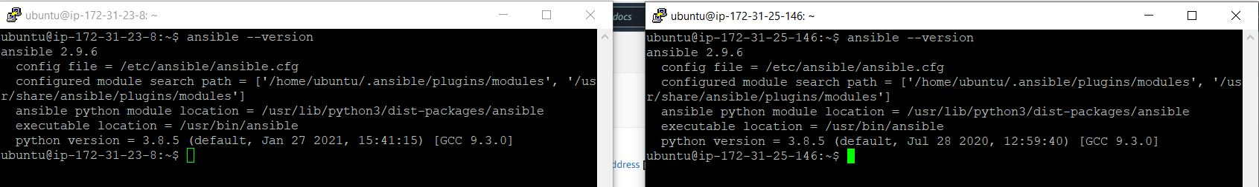
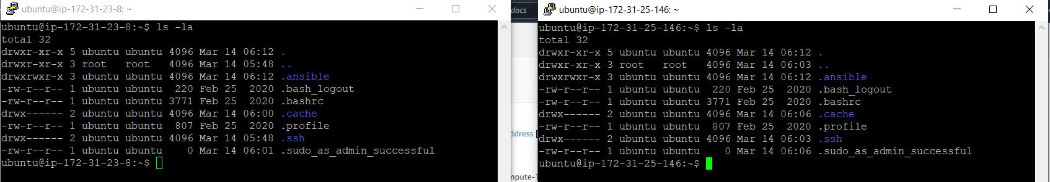
$ ansible --version
$ ls -la

Slide 8
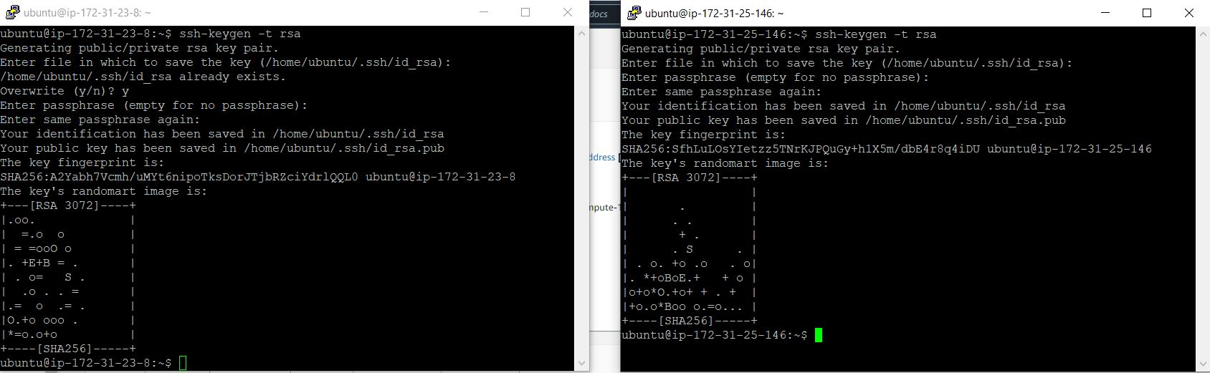
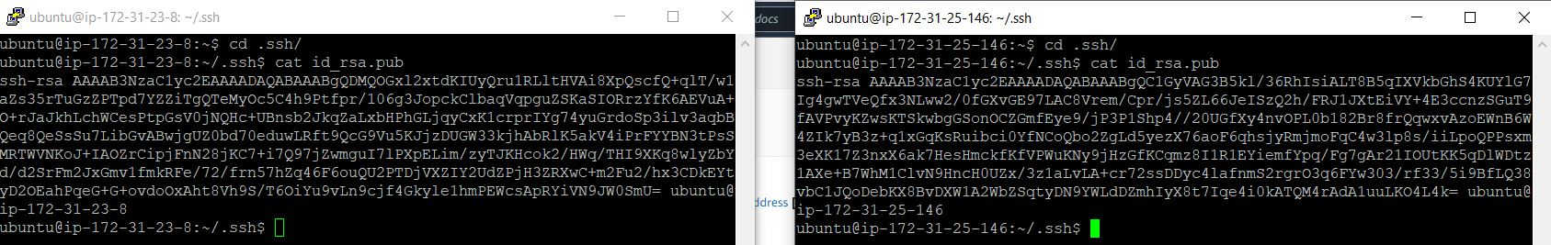
$ ssh-keygen -t rsa
$ cd .ssh/

Slide 9
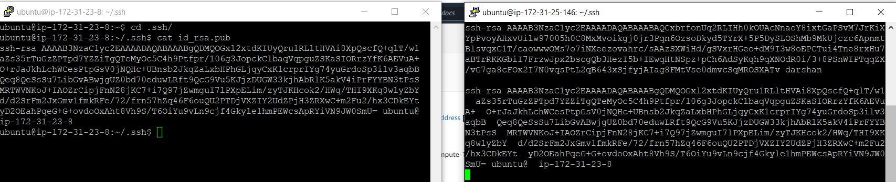
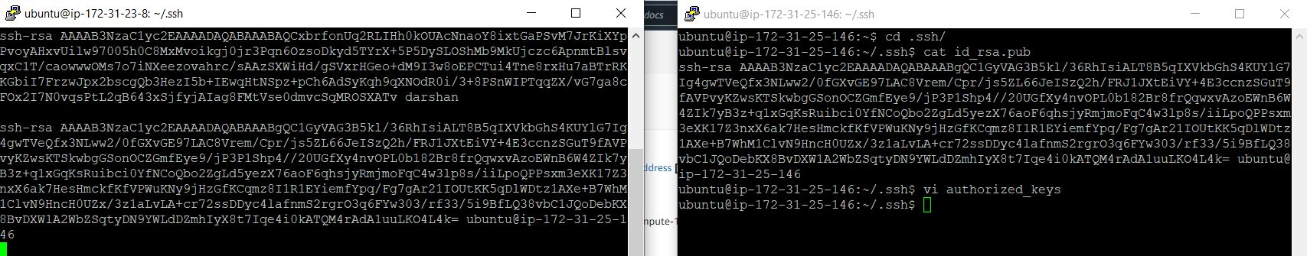
$ cat id_rsa.pub

Slide 10
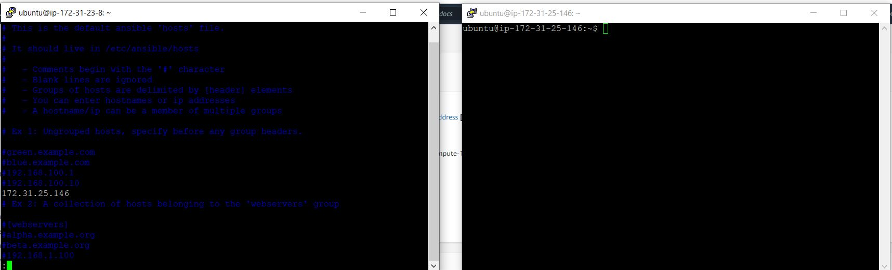
Adding the IP address of the another instance

Slide 11
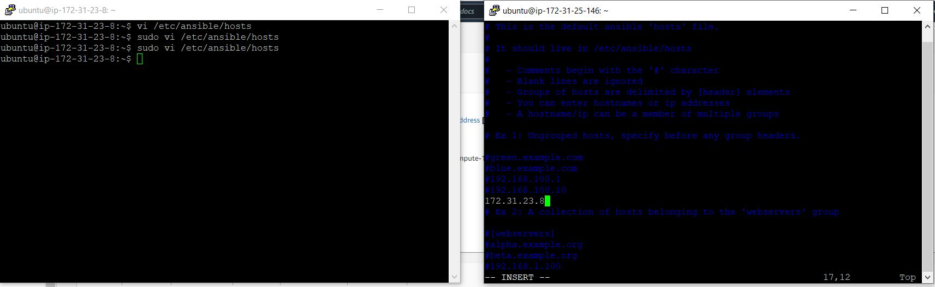
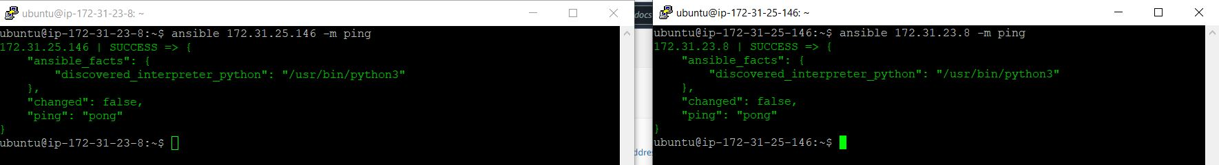
$ sudo vi /etc/ansible/hosts
$ ansible 172.31.25.146 -m ping

Slide 12
Playbook
Playbooks are simple YAML files. These files are descriptions of the desired state of your systems
Playbook contains Plays.
Plays contain tasks.
tasks call modules.

Slide 13
EXAMPLE OF ANSIBLE
Create yaml file
---
- hosts: 172.31.29.210 #server host or group name
become: yes
tasks:
- name: install apache2
apt: name=apache2 update_cache=yes state=latest
- name: enabled mod_rewrite
apache2_module: name=rewrite state=present
notify:
- restart apache2
handlers:
- name: restart apache2
service: name=apache2 state=restarted

Slide 14
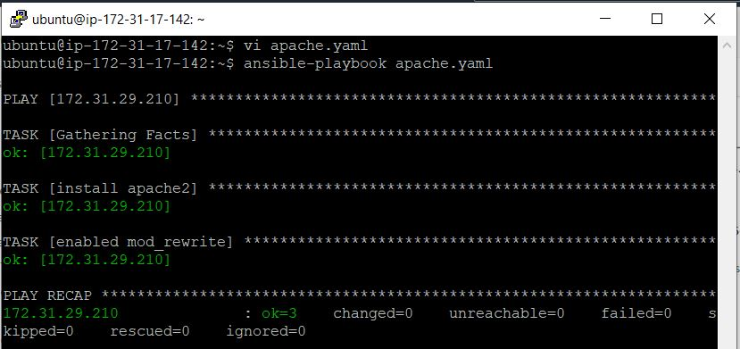
Run the file:
ansible-playbook apache.yaml

Slide 15
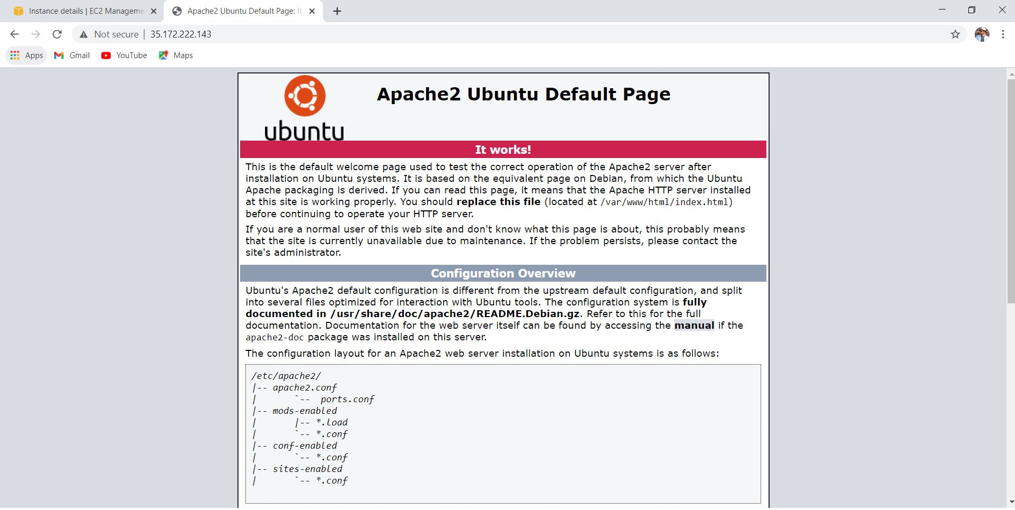

Slide 16

Companies that are using Ansible

Slide 17
THANKYOU

